Slide 1


“Information Security”
Lecture # 4
Dr. Engr. M Malook Rind
Ph.D (I.T), ME (CSN), MBA (MIS), BE (CS)
CCNA, CCNP, Juniper Certified.
Professor (Computer Science)

Slide 2
Contents
Vulnerability Assessment
Risk and Risk Management in Information Security
Social Engineering
Dr. M Malook Rind Information Security Lecture 4

Slide 3

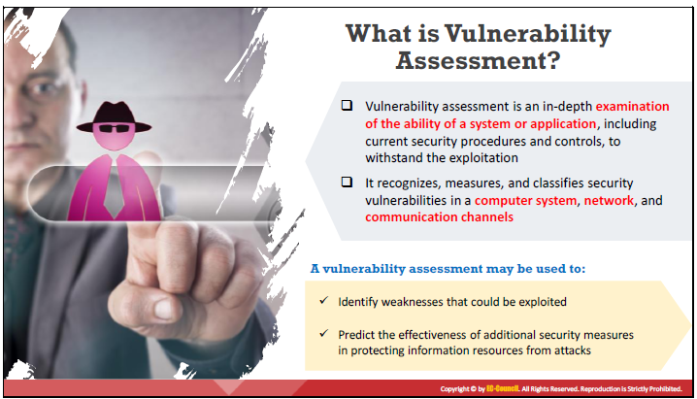
Vulnerability Assessment
A vulnerability assessment is a systematic review of security weaknesses in an information system.
Dr. M Malook Rind Information Security Lecture 4

Slide 4
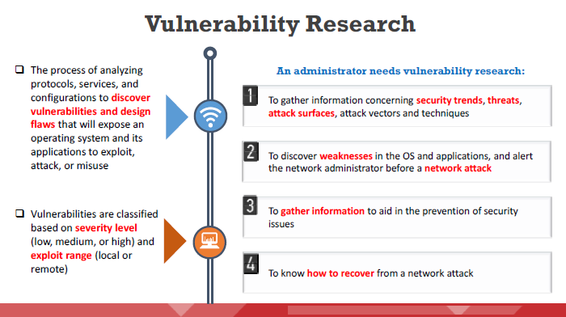
Vulnerability Assessment
Vulnerability assessment plays a major role in providing security to any organization’s resources and infrastructure from various internal and external threats.
Dr. M Malook Rind Information Security Lecture 4

Slide 5
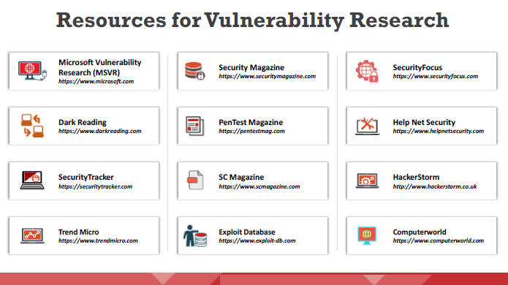
Vulnerability Assessment
The following are some of the online resources/websites used to perform vulnerability research:
Dr. M Malook Rind Information Security Lecture 4

Slide 6
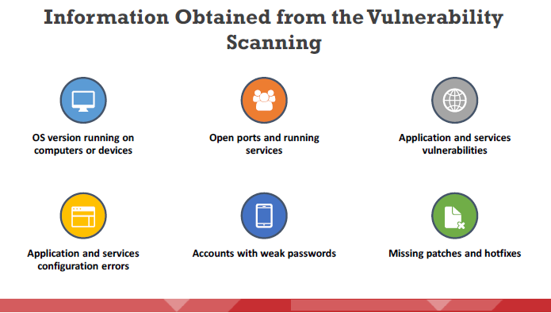
Vulnerability Assessment
Vulnerability scanners are capable of identifying the following information:
Dr. M Malook Rind Information Security Lecture 4

Slide 7
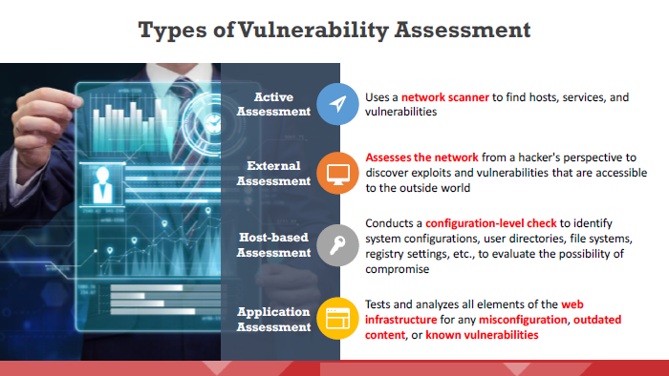
Vulnerability Assessment
Different types of vulnerability assessments
Dr. M Malook Rind Information Security Lecture 4

Slide 8
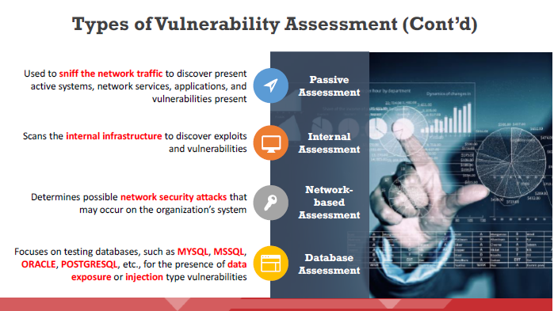
Vulnerability Assessment
Dr. M Malook Rind Information Security Lecture 4

Slide 9
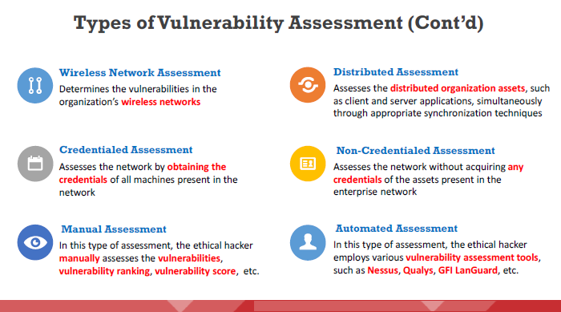
Vulnerability Assessment
Dr. M Malook Rind Information Security Lecture 4

Slide 10
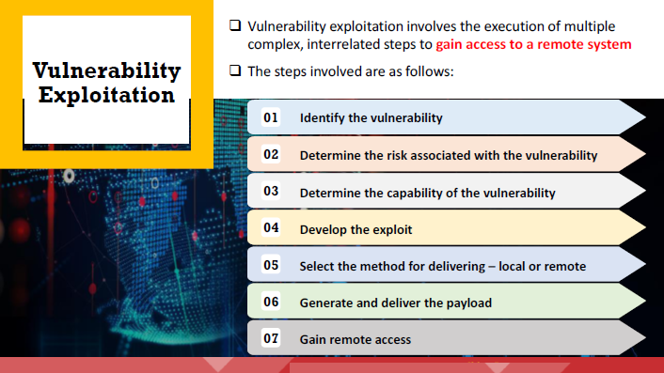
Vulnerability Assessment
Dr. M Malook Rind Information Security Lecture 4

Slide 11
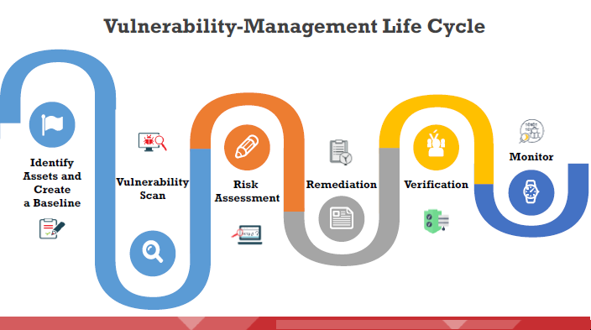
Vulnerability Assessment
The vulnerability management life cycle is an important process that helps identify and remediate security weaknesses before they can be exploited.
Vulnerability management provides the best results when it is implemented in a sequence of well-organized phases
Dr. M Malook Rind Information Security Lecture 4

Slide 12
Vulnerability Assessment
Identify Assets and Create a Baseline: involves the gathering of information about the identified systems, approved ports, software, drivers, and basic configuration of each system in order to develop and maintain a system baseline.
Vulnerability Scan: perform the vulnerability scan to identify vulnerabilities in the organization’s infrastructure and to assess the organization’s Infrastructure weaknesses against the respective compliance guidelines.
Risk Assessment: all serious uncertainties that are associated with the system are assessed, prioritized, remediation is planned to permanently eliminate system flaws. It determines whether the risk level for a particular asset is high, moderate, or low.
Remediation: applying fixes on vulnerable systems in order to reduce the impact and severity of vulnerabilities.
Verification: to performs a re-scan of systems to assess if the required remediation is complete and whether the individual fixes have been applied to the impacted assets.
Monitor: need to perform regular monitoring to maintain system security. They use tools such as IDS/IPS and firewalls. Continuous monitoring identifies potential threats and any new vulnerabilities that have evolved
Dr. M Malook Rind Information Security Lecture 4

Slide 13
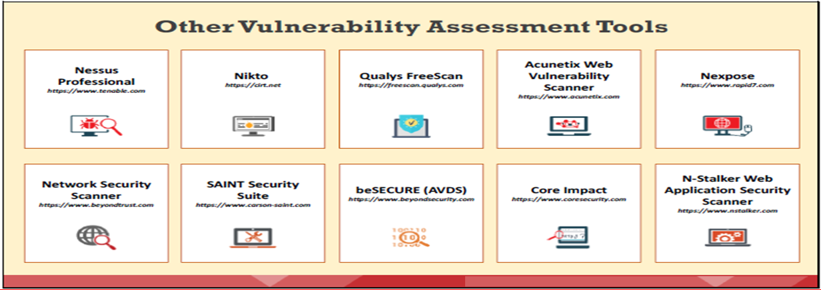
Vulnerability Assessment
An attacker performs vulnerability scanning to identify security loopholes in the target network that they can exploit to launch attacks. Security analysts can use vulnerability assessment tools to identify weaknesses present in the organization’s security posture and remediate the identified vulnerabilities before an attacker exploits them.
Dr. M Malook Rind Information Security Lecture 4

Slide 14
Risk
Dr. M Malook Rind Information Security Lecture 4

Slide 15
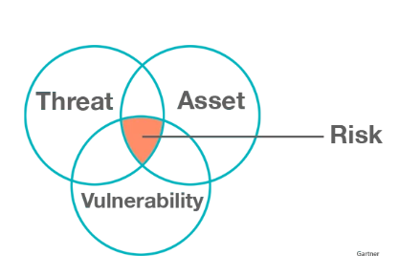
Risk
Risk is the likelihood that a threat will exploit a vulnerability.
Information security risk comprises the impacts to an organization and its stakeholders that could occur due to the threats and vulnerabilities associated with the operation and use of information systems and the environments in which those systems operate.
Risk mitigation reduces the chances that a threat will exploit a vulnerability or reduces the risk’s impact by implementing security controls
Asset + Threat + Vulnerability = Risk
Threat | Risk
A threat is a malicious or negative event that takes advantage of a vulnerability Anything that might exploit a vulnerability | the risk is the potential for loss and damage when the threat does occur. Risk itself is a function of threats taking advantage of vulnerabilities to steal or damage assets
Dr. M Malook Rind Information Security Lecture 4

Slide 16
An Overview of Risk Management
Risk Management is the process of identifying, prioritizing, managing, and monitoring risks to information systems.
Initially, the organization must identify and understand the risk it faces, especially the risk to information assets. Once identified, risk must be assessed, measured, and evaluated.
Know yourself: identify, examine, and understand the information and systems currently in place
Know the enemy: identify, examine, and understand the threats facing the organization
These risks cannot be eliminated, but cyber risk management programs can help reduce the impact and likelihood of threats. Companies use the cybersecurity risk management process to pinpoint their most critical threats and select the right IT security measures based on their business priorities, IT infrastructures, and resource levels.
The Risk Management Process involves three major undertakings:
risk identification
risk assessment
risk control
Dr. M Malook Rind Information Security Lecture 4

Slide 17
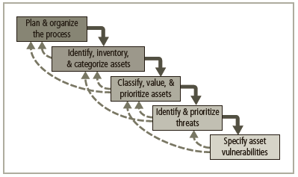
An Overview of Risk Management- Risk Identification
A risk management strategy requires that information security professionals know their organizations’ information assets—that is, how to identify, classify, and prioritize them.
Once the organizational assets have been identified, a threat assessment process is used to identify and quantify the risks facing each asset.
Components of risk identification
Dr. M Malook Rind Information Security Lecture 4

Slide 18
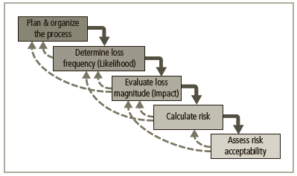
An Overview of Risk Management- Risk Assessment
Risk assessment evaluates the relative risk for each vulnerability.
It assigns a risk rating or score to each information asset.
Planning and organizing risk assessment
The goal at this point is to create a method for evaluating the relative risk of each listed vulnerability
Major stages of risk assessment
Dr. M Malook Rind Information Security Lecture 4

Slide 19
An Overview of Risk Management- Risk Control
Involves selection of control strategies, justification of strategies to upper management, and implementation/monitoring/ongoing assessment of adopted controls
Once the ranked vulnerability risk worksheet is complete, the organization must choose one of five strategies to control each risk:
Defense: Applying safeguards that eliminate or reduce the remaining uncontrolled risk
Accomplished through countering threats, removing asset vulnerabilities, limiting asset access, and adding protective safeguards
Three common methods of risk avoidance:
Application of policy
Education and training
Applying technology
Transfer: share the risk with another party, and rethinking how services are offered
Revising deployment models
Outsourcing
Purchasing insurance
Implementing service contracts
Dr. M Malook Rind Information Security Lecture 4

Slide 20
An Overview of Risk Management- Risk Control
Mitigation: Reducing the impact of information assets should an attacker successfully exploit a vulnerability
Attempts to reduce impact of vulnerability exploitation through planning and preparation
Approach includes three types of plans:
Incident response plan (IRP)
Disaster recovery plan (DRP)
Business continuity plan (BCP)
Disaster recovery plan (DRP) is most common mitigation procedure
The actions to take while incident is in progress is defined in Incident response plan (IRP)
Acceptance: Understanding the consequences of choosing to leave a risk uncontrolled and then properly acknowledging the risk that remains without an attempt at control.
Valid only when the particular function, service, information, or asset does not justify cost of protection
Risk appetite describes the degree to which organization is willing to accept risk as trade-off to the expense of applying controls
Termination: Removing or discontinuing the information asset from the organization's operating environment.
An example of this strategy would be to remove a server from a network because the company has determined that termination of the resource out weighs the benefit of leaving it on the network due to risk concerns.
Dr. M Malook Rind Information Security Lecture 4

Slide 21
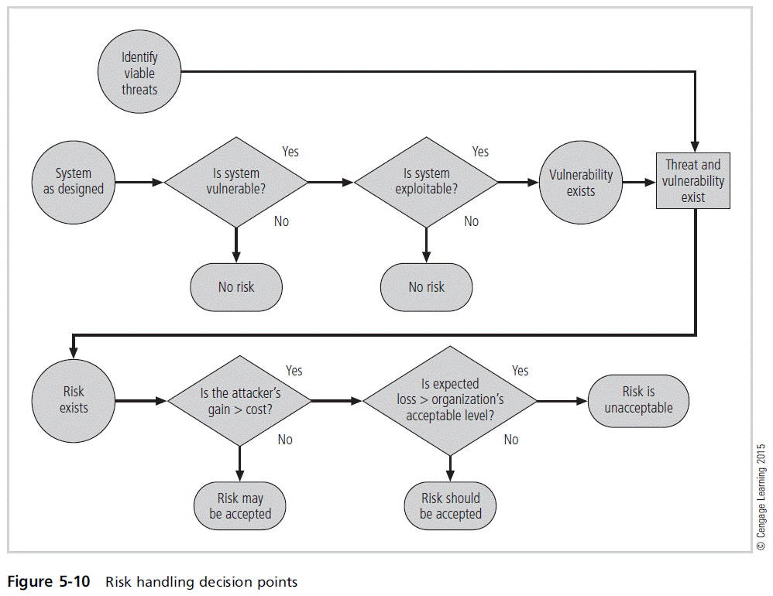
An Overview of Risk Management- Risk Control
Selecting a Risk Control Strategy
Level of threat and value of asset should play a major role in the selection of strategy
Rules of thumb on strategy selection can be applied:
When a vulnerability exists
When a vulnerability can be exploited
When attacker’s cost is less than the potential gain
When potential loss is substantial
Dr. M Malook Rind Information Security Lecture 4

Slide 22
Social Engineering
Dr. M Malook Rind Information Security Lecture 4

Slide 23
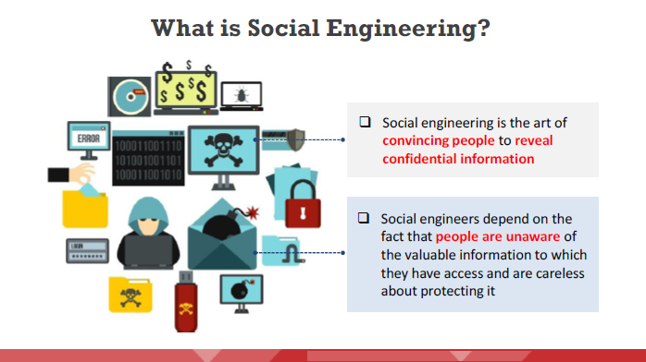
What is Social Engineering
Dr. M Malook Rind Information Security Lecture 4

Slide 24
What is Social Engineering
Before performing a social engineering attack, the attacker gathers information about the
target organization from various sources such as:
The organization’s official websites, where employees’ IDs, names, and email addresses are shared
Advertisements of the target organization cast through media reveal information such as products and offers.
Blogs, forums, and other online spaces where employees share basic personal and organizational information.
After gathering information, an attacker executes social engineering attacks using various
approaches such as impersonation, piggybacking, tailgating, reverse social engineering, and
other methods.
Dr. M Malook Rind Information Security Lecture 4

Slide 25
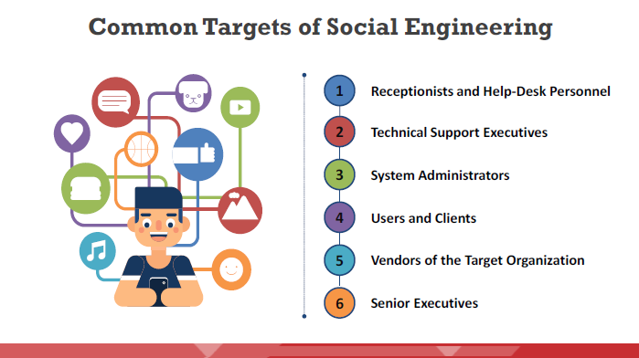
Common Targets of Social Engineering
Dr. M Malook Rind Information Security Lecture 4

Slide 26
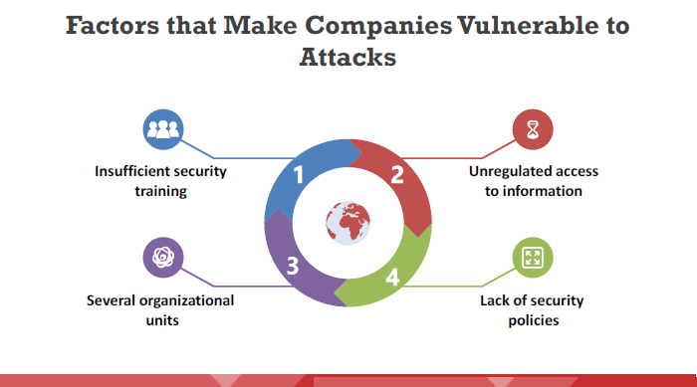
Factors that Make Companies Vulnerable to Attacks
There can be many factors make companies vulnerable to social engineering attacks such as:
Dr. M Malook Rind Information Security Lecture 4

Slide 27
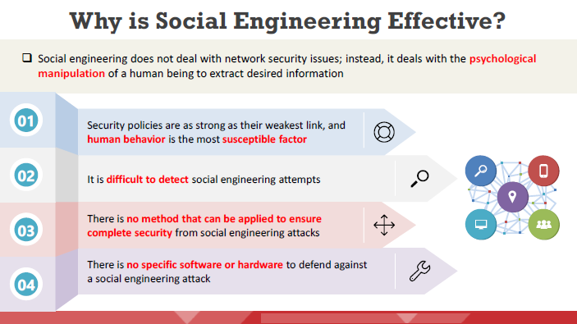
Why is Social Engineering Effective?
Dr. M Malook Rind Information Security Lecture 4

Slide 28
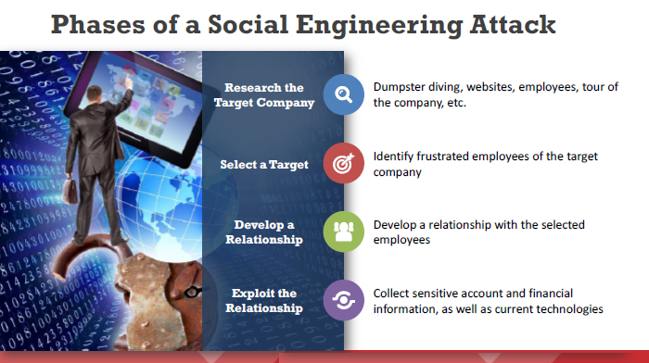
Phases of a Social Engineering Attack
Attackers take the following steps to execute a successful social engineering attack:
Dr. M Malook Rind Information Security Lecture 4

Slide 29
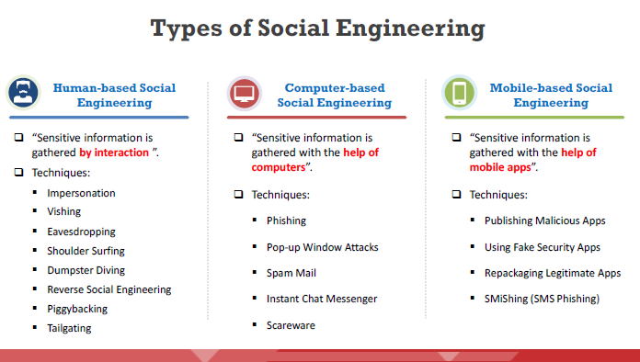
Types of Social Engineering
Attackers implement various social engineering techniques to gather sensitive information from people or organizations that might help them to commit fraud or participate in other criminal activities.
Dr. M Malook Rind Information Security Lecture 4

Slide 30
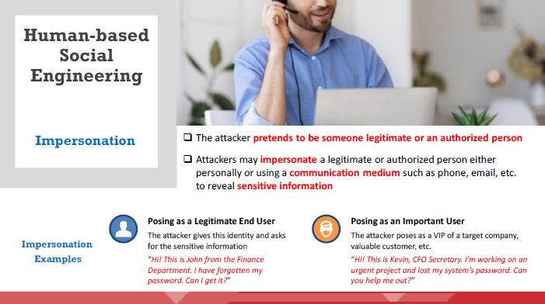
Types of Social Engineering
Dr. M Malook Rind Information Security Lecture 4

Slide 31
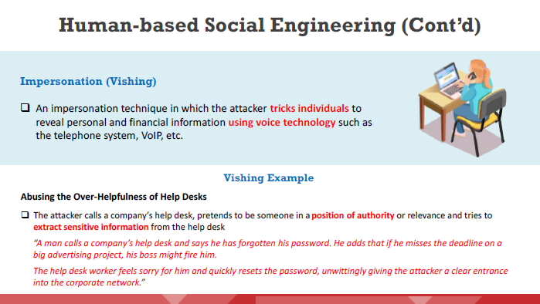
Types of Social Engineering - Human-based Social Engineering
Dr. M Malook Rind Information Security Lecture 4

Slide 32
Types of Social Engineering - Human-based Social Engineering
Dr. M Malook Rind Information Security Lecture 4

Slide 33
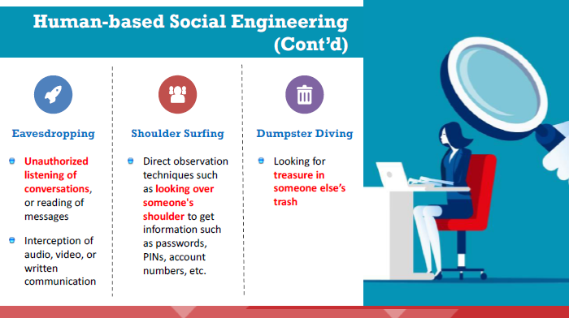
Types of Social Engineering - Human-based Social Engineering
Dr. M Malook Rind Information Security Lecture 4

Slide 34
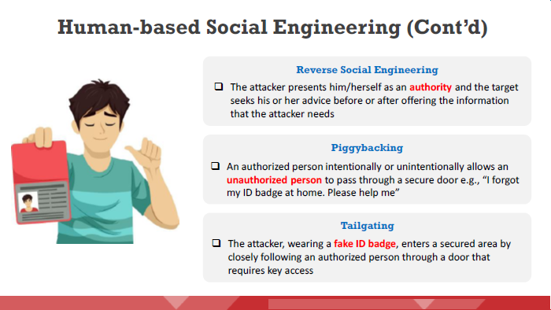
Types of Social Engineering - Human-based Social Engineering
Dr. M Malook Rind Information Security Lecture 4

Slide 35
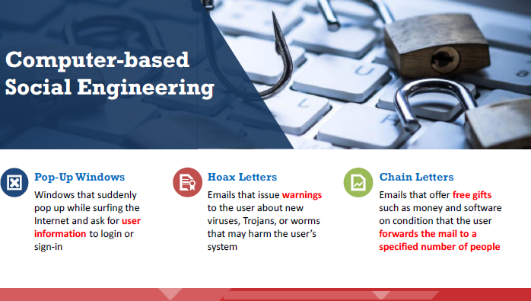
Types of Social Engineering - Computer-based Social Engineering
Dr. M Malook Rind Information Security Lecture 4

Slide 36
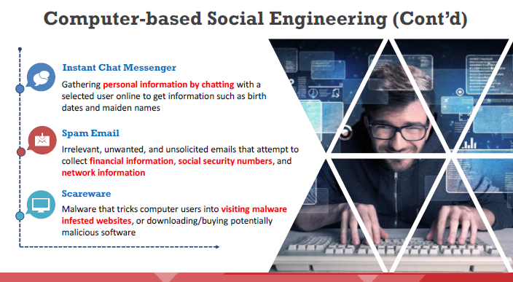
Types of Social Engineering - Computer-based Social Engineering
Attackers
Dr. M Malook Rind Information Security Lecture 4

Slide 37
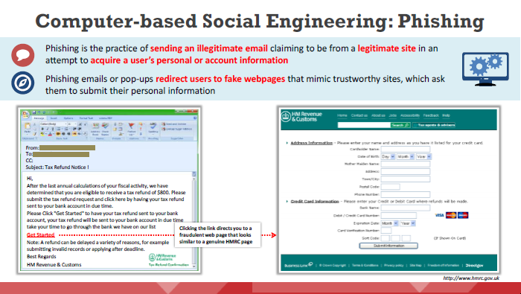
Types of Social Engineering - Computer-based Social Engineering
Dr. M Malook Rind Information Security Lecture 4

Slide 38
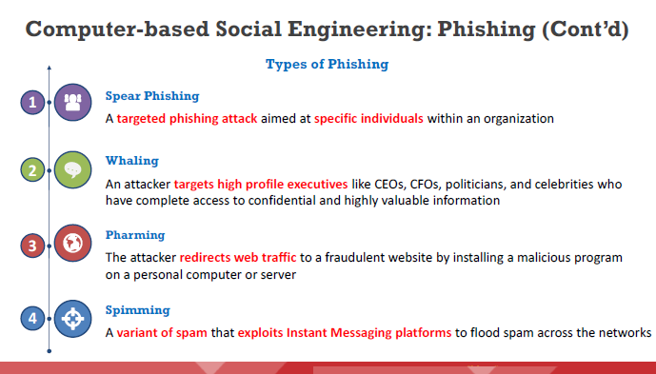
Types of Social Engineering - Computer-based Social Engineering
Dr. M Malook Rind Information Security Lecture 4

Slide 39
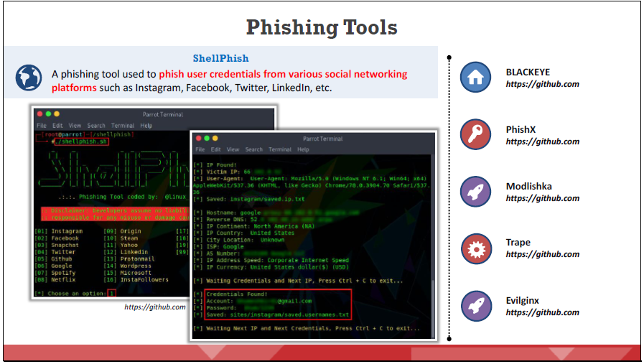
Types of Social Engineering - Computer-based Social Engineering
Dr. M Malook Rind Information Security Lecture 4

Slide 40
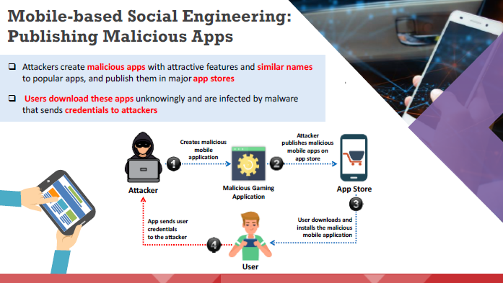
Types of Social Engineering – Mobile-based Social Engineering
Dr. M Malook Rind Information Security Lecture 4

Slide 41
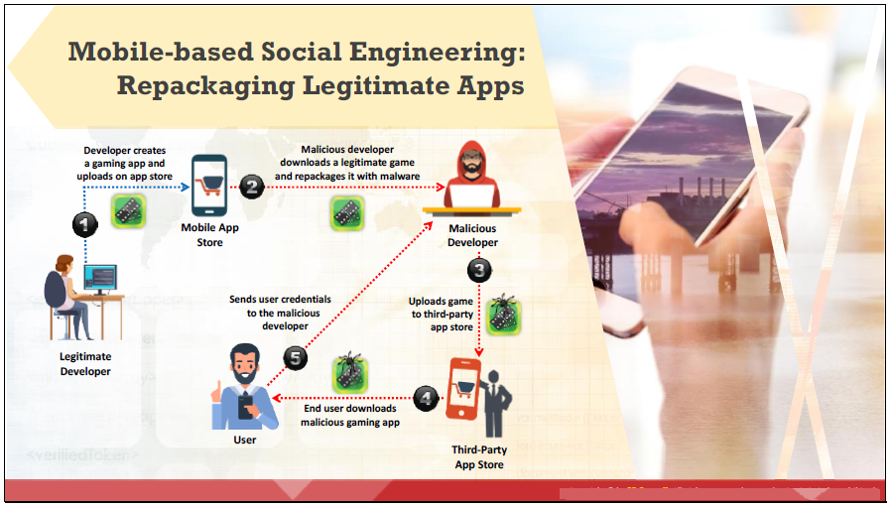
Types of Social Engineering – Mobile-based Social Engineering
Dr. M Malook Rind Information Security Lecture 4

Slide 42
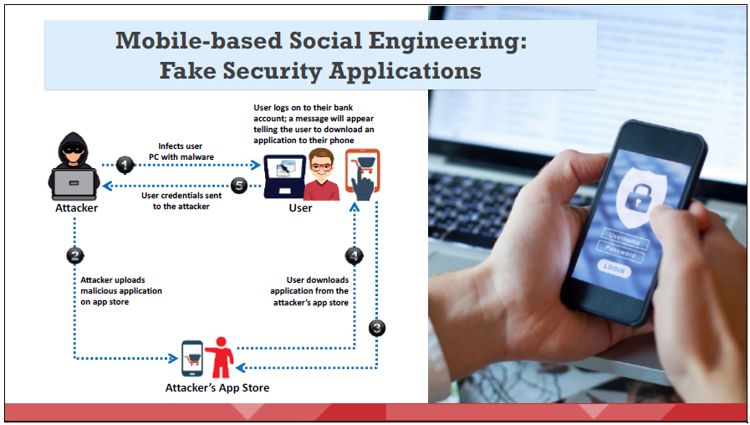
Types of Social Engineering – Mobile-based Social Engineering
Dr. M Malook Rind Information Security Lecture 4

Slide 43
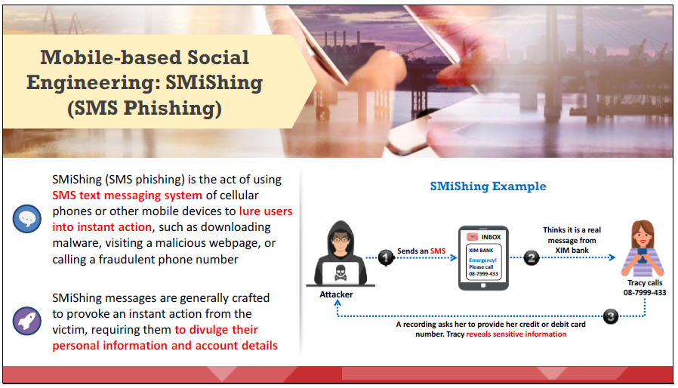
Types of Social Engineering – Mobile-based Social Engineering
Dr. M Malook Rind Information Security Lecture 4

Slide 44
Social Engineering Countermeasures
Social engineering attacks are difficult to guard against, as the victim might not be aware that he or she has been deceived. To guard against social engineering attacks, organizations must develop effective policies and procedures.
To be truly effective, an organization should:
Disseminate policies among employees and provide proper education and training. Specialized training benefits employees in higher-risk positions against social engineering threats.
Obtain employee signatures on a statement acknowledging that they understand the organization’s policies.
Define the consequences of policy violations.
Dr. M Malook Rind Information Security Lecture 4

Slide 45
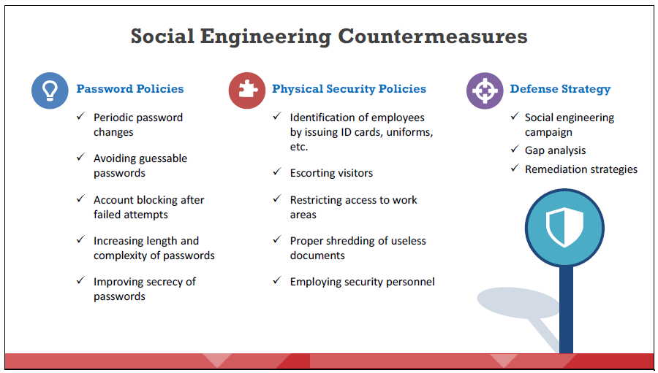
Social Engineering Countermeasures
The main objectives of social engineering defense strategies are to create user awareness, robust internal network controls, and security policies, plans, and processes. They should include the following safeguards:
Dr. M Malook Rind Information Security Lecture 4

Slide 46
Social Engineering Countermeasures
The main objectives of social engineering defense strategies are to create user awareness, robust internal network controls, and security policies, plans, and processes. They should include the following safeguards:
Dr. M Malook Rind Information Security Lecture 4

Slide 47
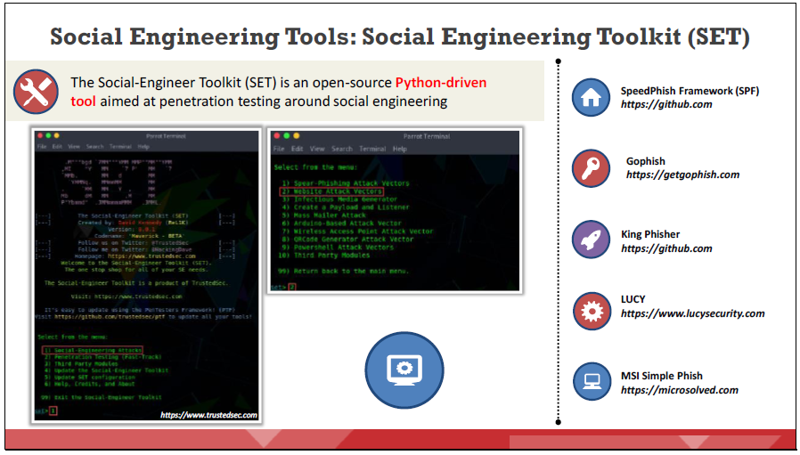
Social Engineering Countermeasures
Dr. M Malook Rind Information Security Lecture 4

Slide 48
Thanks
Dr. M Malook Rind Information Security Lecture 4

